Slide 1
Smart Cities and Public Infrastructure: Enhancing Urban Living through AI-driven Customer Insights
Team : BITMASTERS

Slide 2
INTRODUCTION
Welcome to our exploration of smart cities, where AI-driven customer insights are revolutionizing urban living. By leveraging advanced technologies to optimize public infrastructure and services, we can create more responsive, efficient, and vibrant urban environments, significantly enhancing the quality of life for all residents.
Team Members:
Aaron James Koshy
Jobin Tom
Chandrasekhar C A

Slide 3
WHAT ARE WE SOLVING ?

Slide 4
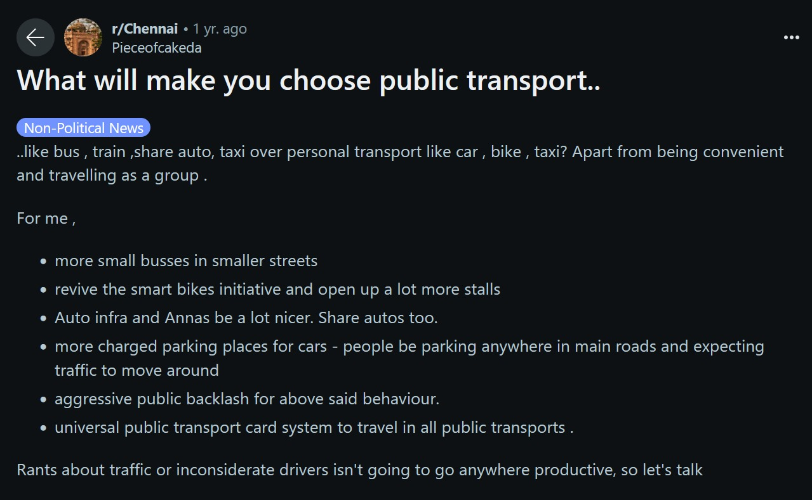

Slide 5
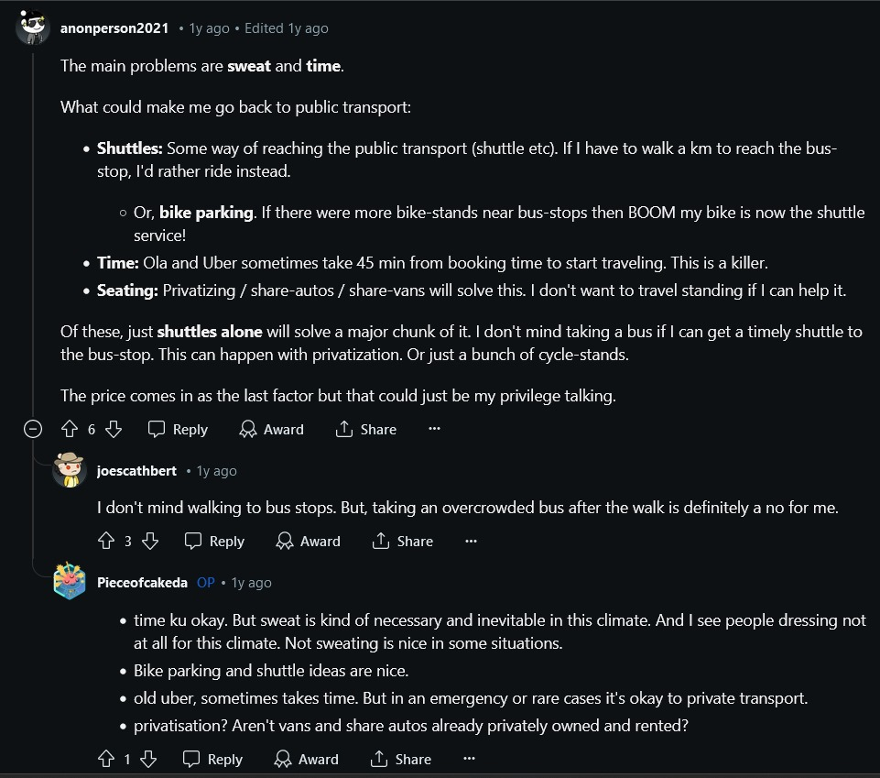

Slide 6
NOW WHAT ?

Slide 7
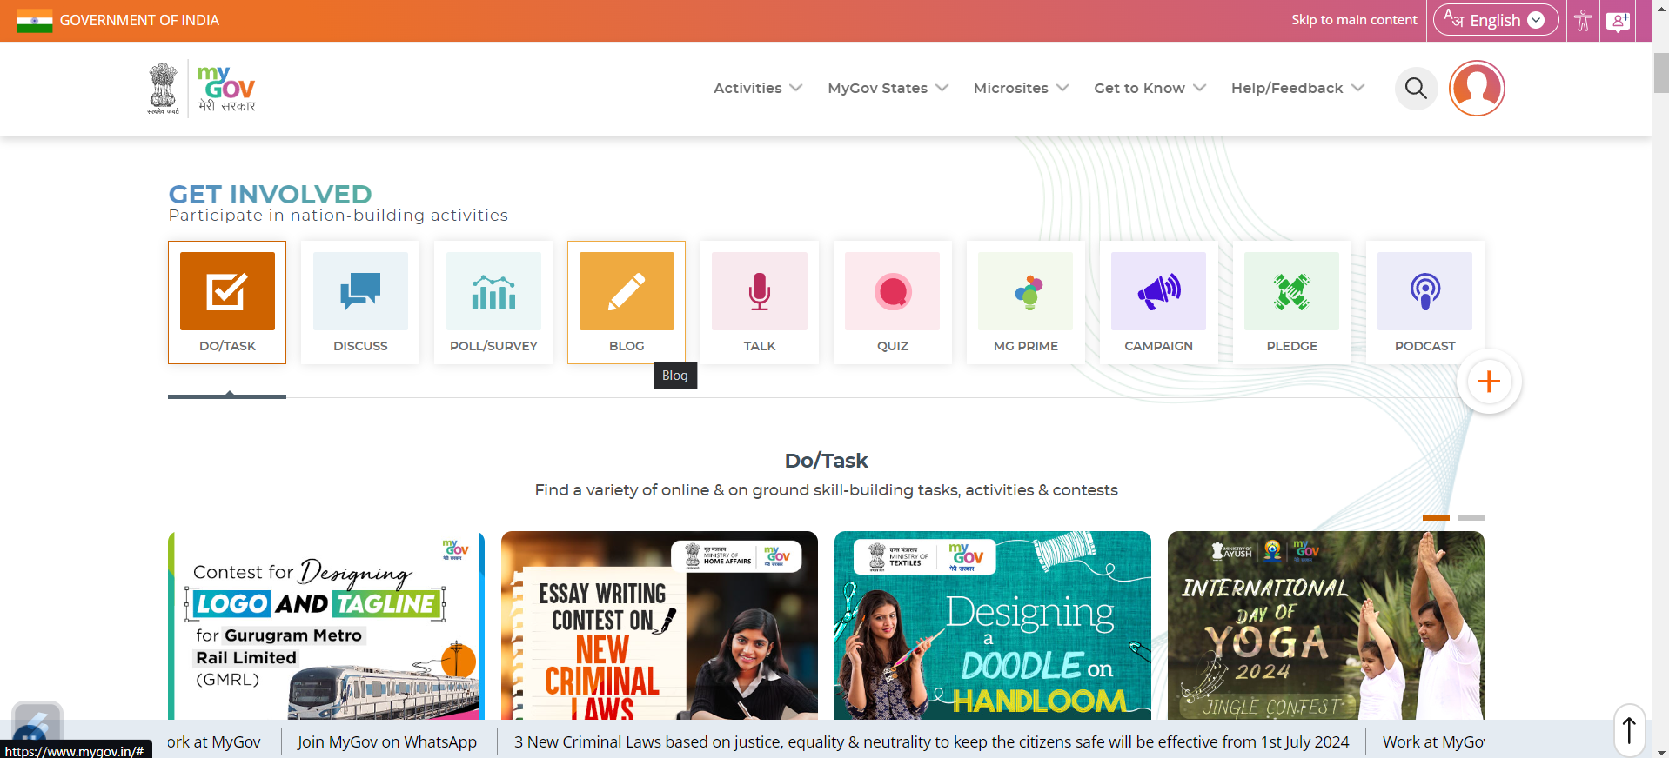
EXISTING SOLUTIONS
EXISTING SOLUTIONS
https://www.mygov.in/

Slide 8
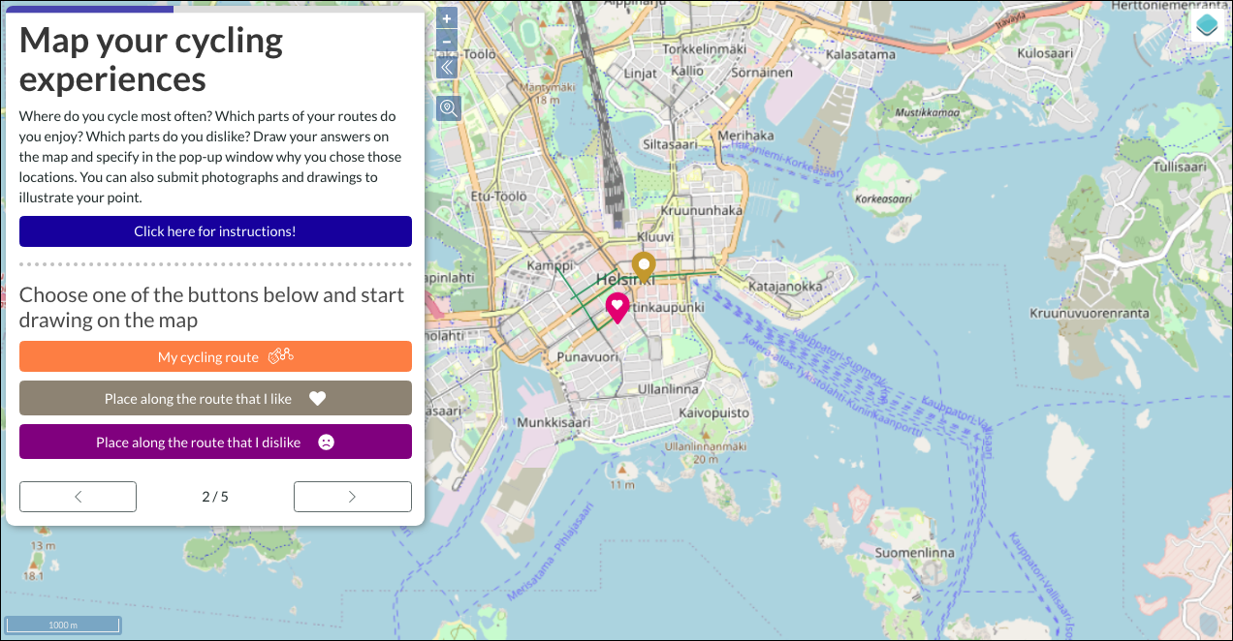
https://www.maptionnaire.com/

Slide 9

OUR SOLUTION
CITY FORUM
Watsonx AI
INSIGHT

Slide 10
WHO DOES THIS BENEFIT ?
Governments
Businesses
Engineers
Citizens
Environmental Advocates
Technology Enthusiasts and Developers

Slide 11
CONCLUSION
Our solution bridges the gap between citizens and city planners by providing a platform for discussion and a robust analytical tool to interpret public sentiment. This leads to more informed, transparent, and inclusive decision-making, ultimately fostering a city environment that is better suited to the needs and preferences of its residents. The implementation of our solution can significantly enhance the quality of life in smart cities and ensure sustainable, community-driven urban development.
FUTURE SCOPE
Integration with other data sources.
Multi language support.
Enhanced user engagement.
Collaboration with urban researchers.

